Slide 1
LANGUAGE IDENTIFICATION
NLP & Information Extraction
Rebecca Micol Finzi Olesia Galynskaia Yeongshin Park Julia Chalissery
(12505266) (12321492) (12432938) (52007582)

Slide 2

Mission:
Build a multilingual dataset for automatic language identification

Slide 3
OVERVIEW
Final Model
And
Evaluation
Multiple Baseline Solutions
Pre-processing

Slide 4
Dataset - Multilingual Wikipedia Dataset (Hugging Face)
https://huggingface.co/datasets/wikimedia/wikipedia
- Twitter dataset (out-of-distribution evaluation)
Languages - Italian (it) Spanish (es)
Tamil (ta) English (en)
Belarusian (be) Portuguese (pt)
Russian (ru) French (fr)
German (de) Korean (kr)

Slide 5

Milestone 1: PREPROCESSING
Design to produce a multilingual dataset that is
Clean
Consistent
Standardized

Slide 6

Preprocessing
- Removal of unwanted characters
- Whitespace normalization
- Tokenization
- Saving in CoNLL format
- excluded stopword removal, stemming and lemmatization

Slide 7

To run
- Run all languages sequentially
chmod +x run.sh
./run.sh
- Run a single language manually
python preprocessing.py -lang en -n 10000

Slide 8
Data and Configuration
- each lang. processed using 10,000 wiki pages (balance b/w computational cost & representativeness)
- cleaned text (lang. appropriate alphabets, digits and punctuation marks)
- Google Drive instead of GitHub (file size limitation)

Slide 9
Potential Issues
- Data Bias
- Tokenization Accuracy
- Language Characteristics
- Large Scale Data Handling

Slide 10

Milestone 2: MULTIPLE BASELINE SOLUTIONS
Two baselines have been implemented:
Rule based models
Machine learning models (Naive Bayes)
Evaluation:
Quantitative (accuracy, precision, recall, F1)
Qualitative (error and confusion analysis)

Slide 11
Rule-Based Model
Training-free:
Uses explicit linguistic rules instead of learned parameters
Fully interpretable and deterministic
Methodology:
Script Detection (Latin, Cyrillic, Hangul, Tamil)
Character n-grams (bi-, tri-, four-grams)
Score each language
Predict language:
highest score → language
0 → unknown
Rule-Based Model
Rule-Based Model

Slide 12
Hyperparameter Search
Parameters tested:
max_sent_per_lang
top_k_n_grams
weight
→ Total: 36 Configuration

Slide 13
Rule-Based Results
Final Configuration:
max_sent_per_lang = 50,000
top_k_n_grams = 40
weights = base
Performance:
Accuracy: 93.9%
Stable and fast
No training required
Typical Confusions:
be ↔ ru (Cyrillic)
es ↔ pt / it / fr (Romance)
de ↔ en (Latin)
→ Errors reflect real linguistic similarity

Slide 14
2. ML Baseline Model
Multinomial Naive Bayes classifier
Methodology:
Data: 6,669,377 sentences from CoNLL-U files
Features: TF-IDF (top 1,000 features)
Split: 80/20
Why Naive Bayes?
Simple and fast
Well-suited for text classification
Strong baseline performance

Slide 15
ML Baseline Results
Performance:
Accuracy: 87.27%
Strong performers:
Tamil, German, Italian, English (>95% F1)
Challenges:
Belarusian (F1: 0.39) → confused with Russian
Korean (F1: 0.39) → low recall despite unique script
Russian → high recall but low precision

Slide 16

Milestone 3: FINAL MODEL
RULE-AUGMENTED XLM-ROBERTa
This model identifies languages by combining
Rule-based language detector
XLM-ROBERTa

Slide 17
Key Idea
- Rule based model extracts linguistic signals (writing system, stopwords, special characters, character n-grams )
- signals → special tokens
- tokens → input text
- XLM-ROBERTa
- fine-tuned on input
- internal parameters learn rule
based signals during training

Slide 18
Rule Based Tag
- Each input prefixed with token<SCRIPT=CYRILLIC> <RB=ru> <RB_CONF=HIGH>
- Token encode
- detected writing systems
- rule based language prediction
- confidence level

Slide 19
To run
- python3 -m final_model.main
- load wiki data
- split train/test
- train rule-augmented XLM-ROBERTa
- Evaluation

Slide 20
Evaluation
- final model compared to baseline with
- in-domain evaluation
(wiki test-split - measure performance
on data with same distribution)
- out-of-distribution evaluation
(twitter dataset - evaluate
robustness and generalization)

Slide 21
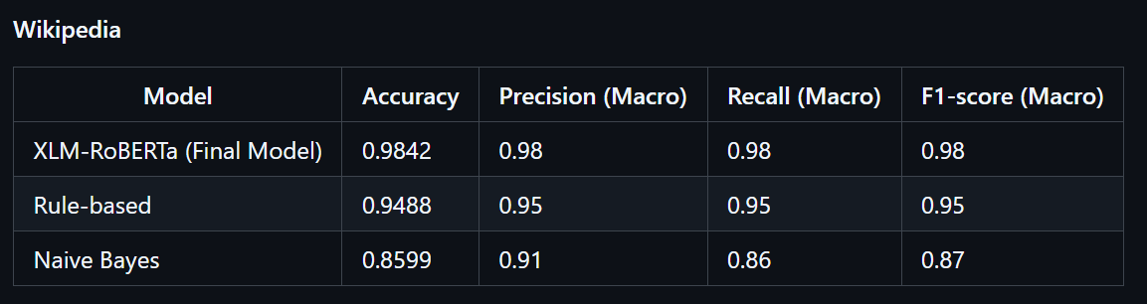
Results

Slide 22
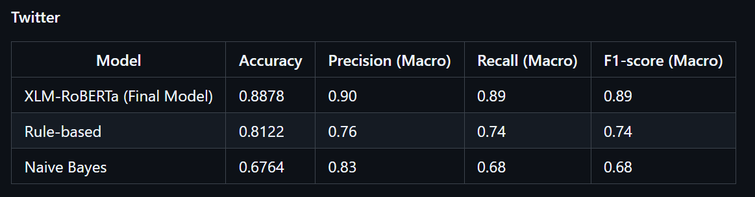
Results

Slide 23
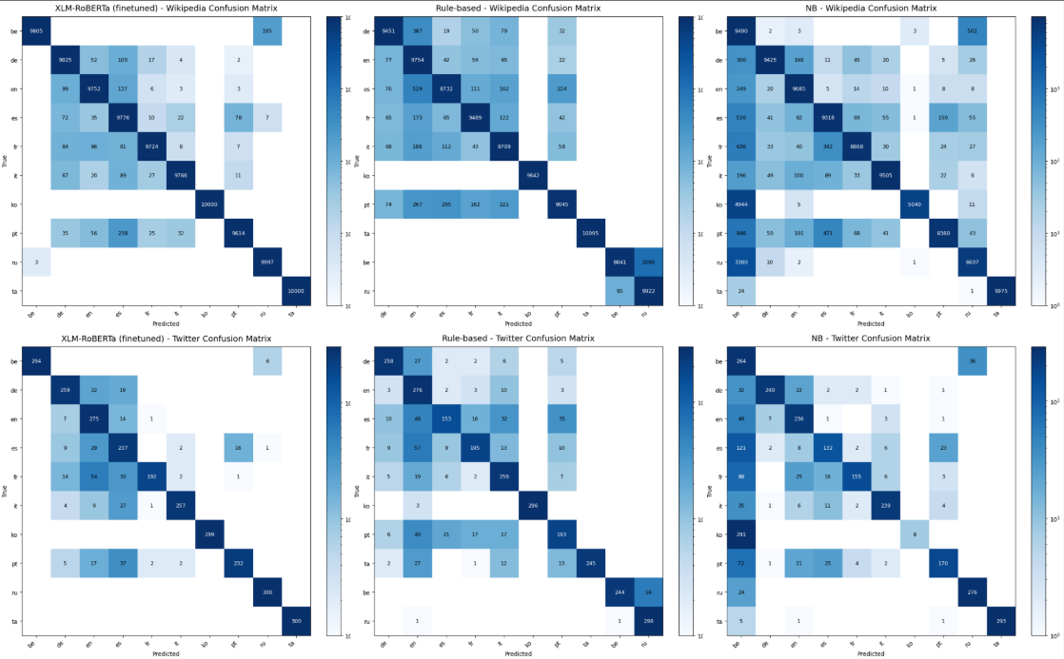
Results
- shared script →
most errors
- Fine-tuned
XLM-ROBERTa
has fewer
misclassifications
- pattern observed on
Wiki dataset and on
robust twitter dataset

Slide 24
THE TEAM
Rebecca Micol
Olesia Galynskaia
Yeongshin Park
Julia Chalissery
Preprocessing, Final Model Evaluation
Preprocessing, Rule-Based Model
Preprocessing, Final Model Evaluation
Preprocessing, Machine Learning Model

Slide 25

THANK YOU

